Slide 1



Integrated Climate Change Adaptation (CCA) and Flood Risk management Strategy and Plan for the Drin River Basin
DRAFT
Transboundary FRM Action Plan &
FRM Strategy of the Drin River Basin
2025 - 2031
Nov. 2024

Slide 2
Table of Contents
Status of FRM in the Riparian Countries
The Spatial Scale of the Drin FRM Plan
The Drin FRM Strategy (DRAFT)
Multi-Criteria Optioneering Analysis. (Scoring & Ranking of the FRM Measures for Preparing the Drin FRM Action Plans)
Summary Table, High-Priority Transboundary FRM Measures
Summary Table, High Priority Specific FRM Actions By Homogeneous Flooding Macro-Areas (Alban Doko)*
Consultation Process, Stakeholder Engagement for Validation of the FRM Strategy & FRM Action Plan (Novak Cadjenovic)*

Slide 3
Status of FRM in the Riparian Countries
Drin/Drim – Buna/Bojana River Basin – EU Floods Directive
APSFR – Preliminary FR Assessment
(Art. 4, Art. 5)
1
KOSOVO
Flood Hazard Maps for APSFRs
(Art. 6(1))
NORTH MACEDONIA
MONTENEGRO
2
ALBANIA
Flood Risk Maps/ Vulnerability, Damage Assess. (Art. 6 (5))
Flood Risk Management Plans
(Art. 7)
Transboundary FRM Plan for the Drin River Basin (Art. 8)
3
The Transboundary FRM Plan shall be based on a Transboundary FRM Strategy

Slide 4
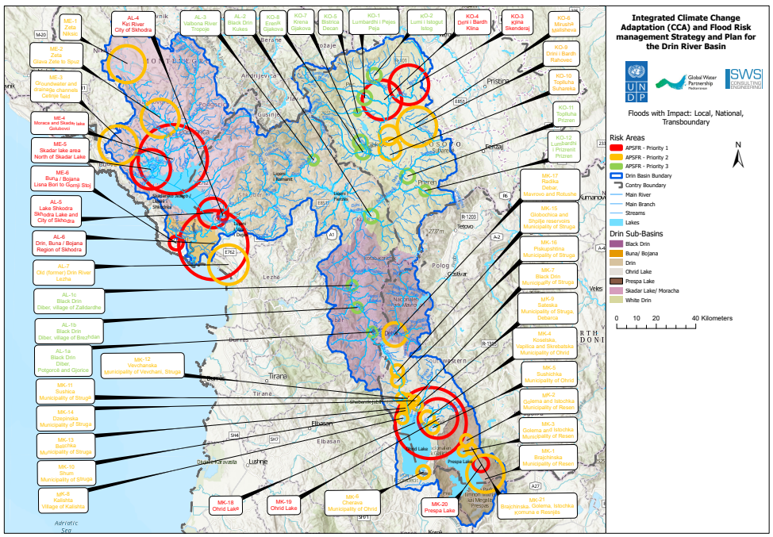
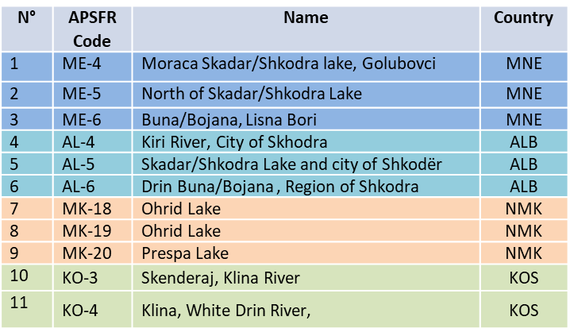
Areas of Mutual Concern - AMC
Based on GIZ’s PFRA (The only FRM study at the Transboundary level)
The FRM Action Plan will focus on the selected AMC (11)
Multi-Criteria Analysis for Selection of the AMC

Slide 5
THE SPATIAL SCALE OF THE DRIN FRM PLAN
The Homogeneous Flooding
Macro-Areas

Slide 6
Spatial Scale of the FRM Action Plan
PRELIMINARY ANALYSIS
What Extension & Spatial Scale (Admin / Riparian Level, Sub-basin Level) ?
Number of FRM Action Plans (One Transboundary FRM AP, or more than One ) ?
SELECTED CRITERIA: HOMOGENEOUS FLOODING MACRO-AREAS
Based on “Guidance for Reporting of the EU Flood Directive”, Classification of the Floods according to their own characteristics
Mechanism of Flooding (How, and Why Floods Happen) Natural Exceedance, Defense Exceedance, Infrastructure Failure, Blockage / Restriction, Other.
Characteristics of Flooding (Hydrological Regime, Spatial & Temporal Dynamics) Flash Flood, Snow Melt, Rapid On-set, Medium On-set, Slow On-set, Debris flow, High Velocity, Other.
Source of Flooding (Origin of the Floods) Fluvial, Pluvial, Ground-Water, Sea Water, Artificial, Other.

Slide 7
Areas of Mutual Concern & Flooding Mechanism
Flooding Macro-Area | AMCs | Name | Type of Floods | Mechanism of Flooding | Source of Flooding
Lower Drin | ME-4 | Moraca Skadar/Shkodra lake | Flash Flood / Medium onset floods | Natural exceedance | Pluvial
 | ME-5 | North of Skadar/Shkodra Lake |  | Natural exceedance | Pluvial
 | ME-6 | Buna/Bojana | Slow onset floods | Natural & defense exceedance | Fluvial
 | AL-5 | Skadar/Shkodra Lake and city of Shkodër |  | Defense exceedance | Fluvial
 | AL-6 | Drin Buna/Bojana , Region of Skhodra |  | Defense exceedance | Fluvial
 | AL-7 | Lezhe |  | Defense exceedance | Pluvial
 | AL-4 | Kiri River, City of Skhodra | Flash Floods | Defense exceedance | Pluvial
Upper Lakes | MK-18 | Ohrid Lake | Medium onset floods | Natural exceedance | Pluvial
 | MK-19 | Ohrid Lake - Lake-flood
 | MK-20 | Prespa Lake
White Drin | KO-3 | Skenderaj, river Klina | Flash Floods | Natural exceedance | Pluvial
 | KO-4 | Klina, river Drini I Bardh
Drin Cascade | ---- | ---- | Slow onset floods | Infrastructure / Reservoir | Pluvial
Middle / Upper Skadar | ---- | ---- | Flash Flood / Medium onset floods | Natural exceedance | Pluvial

Slide 8
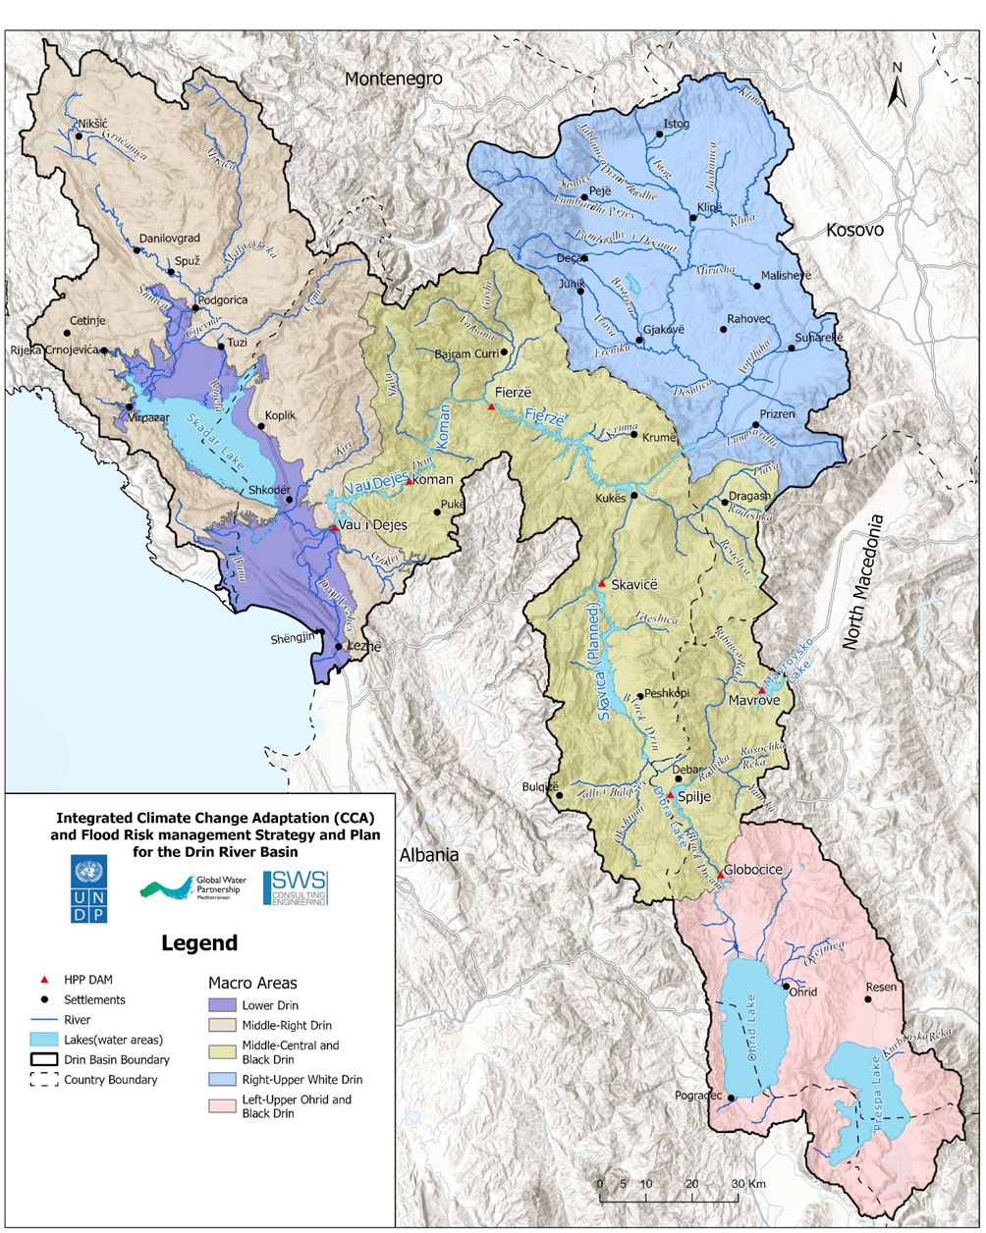
Homogenous Flooding Macro-areas
Advantages of the HFM
Harmonization: most FRM measures can be considered common or similar (same Category)
Coordination: Common implementation of FRM measures by the riparian countries
Prioritization: Facilitate flood governance and identification of the High Priority FRM interventions
Floods Control Factors: Natural & anthropic factors that regulate the dynamics of the floods, and must be carefully considered

Slide 9
THE DRIN FRM STRATEGY
2025 – 2031
(DRAFT)*

Slide 10
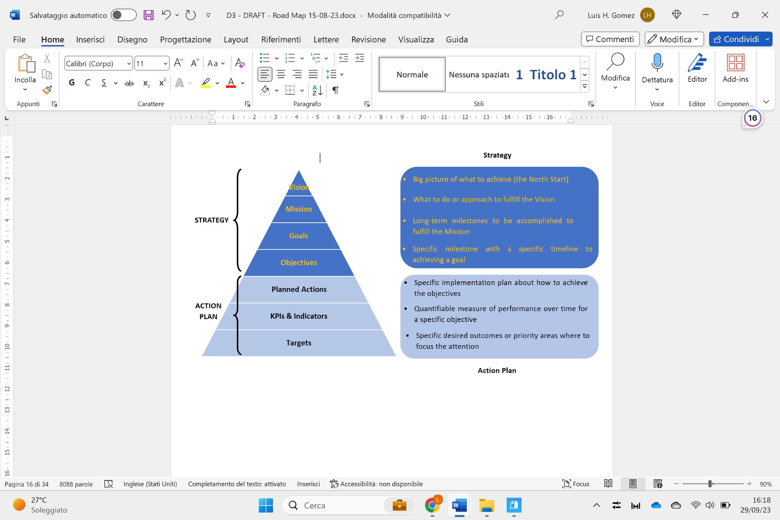
Conceptual Approach of FRM Strategy & FRM Action Plan

Slide 11
Drin FRM Strategy
VISION & MISSION
VISION | Long/Medium Term (2025 - 2043): Reaffirms Shared Vision of MoU (2011). “Coordinated Integrated Management of the Shared Water Resources as a Means to ………… Promote Sustainable Development across the Drin Basin”
 | Short-Term (2025 - 2031): Make the Drin Basin’s Communities Resilient and able to Adapt to Climate Change Challenges
MISSION | Drin’s Basin Communities are Prepared to Cope against extreme Hydro-Climatic events (100 Years Return Period)
  Oriented to Strengthening the Resilience of
  Drin’s Basin Communities)

Slide 12
Drin FRM Strategy
The VISION & MISSION are underpinned by Axis of Action / Strategic Goals, Strategic Objectives, Specific Objectives, Sub-Objectives, and Outcomes
Selected to be Feasible Technically & Financial (in the Short Term 6Y)
Axis of Action
STRATEGIC GOALS
Axe n° 1
Ensure Flood Risk Awareness, Preparedness & Good Governance
Axe n° 2
Axe n° 3
Incentive Nature Based Solutions & No-Regret Climate Adaptation Measures
Promote Equitable Transboundary Cooperation and Bottom-Up Community Based Projects
Axe n° 4
Maximize the Financial Resources (Cross-sector)

Slide 13
Axis of Action I: STRATEGIC GOALS & OBJECTIVES
  Each Strategic Goal is underpinned by a set of Objectives and Specific Objectives
SG I: ENSURE FLOOD RISK AWARENESS, PREPAREDNESS & GOOD GOVERNANCE SO I: Improving the transboundary Drin Flood Forecasting and Early Warning System to ensure timely and accurate alerts by 2031
Objective 1: Strengthen the Drin/Drim-Buna/Bojana Basin FFS - Flow & Flood Forecasting System supplied by the German cooperation (GIZ) to all riparian countries (ALB, MNE, KOS, NMK) by 2031. Objective 2: Establish an operational mechanism among the riparian hydro-power companies for planned and coordinated regulation of the spillway discharges to minimize the downstream risk of flooding by 2031. Objective 3: Promote a greater Municipal integrated urban planning & land-use management to avoid the construction of new settlements, commercial, and industrial activities within high-risk flood areas by 2031.

Slide 14
Axis of Action II: STRATEGIC GOALS & OBJECTIVES
  Each Strategic Goal is underpinned by a set of Objectives and Specific Objectives
SG II: INCENTIVE NATURE-BASED SOLUTIONS & NO-REGRET CLIMATE ADAPTATION MEASURES SO II: Incentivize the extensive construction of Nature Based Solutions (NbS) to increase soil-water storage and reduce the peak of floods by 2031
Objective 1: Incentivize economically the afforestation and the naturalization of the upper sub-basins by 2031. Objective 2: Incentivize economically the recovery, naturalization, conservation, and ecological revitalization of the wetlands, coastal lagoons, and marshlands in the lower Drin Buna/Bojana area by 2031.

Slide 15
Axis of Action III: SPECIFIC OBJECTIVES & OUTCOMES
  Each Strategic Goal is underpinned by a set of Objectives and Specific Objectives
SG III: PROMOTE EQUITABLE TRANSBOUNDARY COOPERATION & BOTTOM-UP COMMUNITY BASED PROJECTS SO III: Promote the preparation of Sub-Basin/Municipal Flood Risk Management Action Plans (LFRMAP) by 2031
Objective 1: Incentivize the creation of Sub-Basin/Municipal Civil Protection Committees in the high-risk flooding areas by 2031.

Slide 16
Axis of Action IV: STRATEGIC GOALS & OBJECTIVES
  Each Strategic Goal is underpinned by a set of Objectives and Sub-objectives
SG IV: MAXIMIZE FINANCIAL RESOURCES (Cross-sector) SO IV: Identify new financial resources to fund the implementation of the Transboundary Flood Risk Management Action Plans by 2031
Objective 1: Preparation of new international proposals and initiatives to get funding for the Flood Risk Management Sector by 2031. Objective 2: Promote the development of flood insurance and other Internal risk-financing mechanisms by 2031

Slide 17
MULTI-CRITERIA OPTIONEERING ANALYSIS
Scoring, Prioritization, and Ranking of the FRM Measures for Preparing the Drin FRM Action Plans

Slide 18
Harmonized Catalog of FRM Measures for the Transboundary Drin River Basin
In the last 20 years, several projects in the Flood Risk sector have been carried out (based on the EU Floods Directive), unfortunately, most of them have used their own categories of FRM Measures preventing the inter-comparison and a transboundary analysis.
Based on the Guidance for Reporting of the EU Floods Directive (18 FRM Categories)

Slide 19
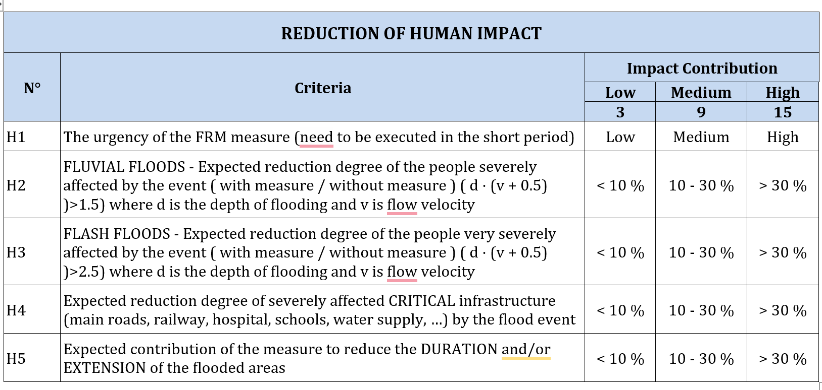
Scoring of the FRM Measures by H.F. Macro-area
Multi-Criteria Optioneering Analysis Tables
To assess the contribution of a FRM Measure reducing the flood level of risk, Four (4) impact categories and 15 sub-criteria were used (by H.F. Macro-area)
Optioneering Analysis Table
Human Impact Category, sub-criteria (H1 – H5), classes of impact reduction (Low, Medium, High), and Scores (3, 9, 15)

Slide 20
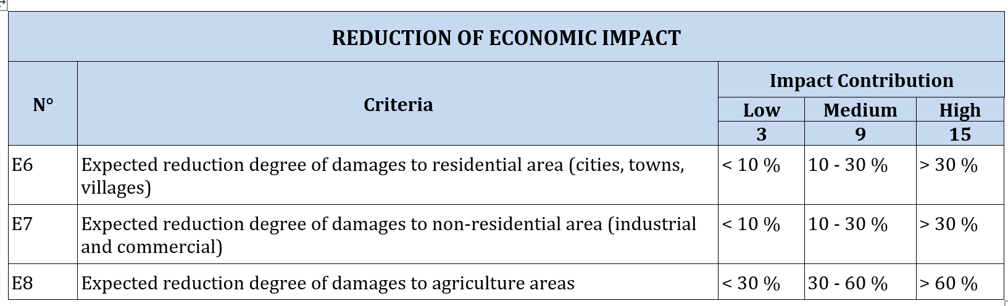
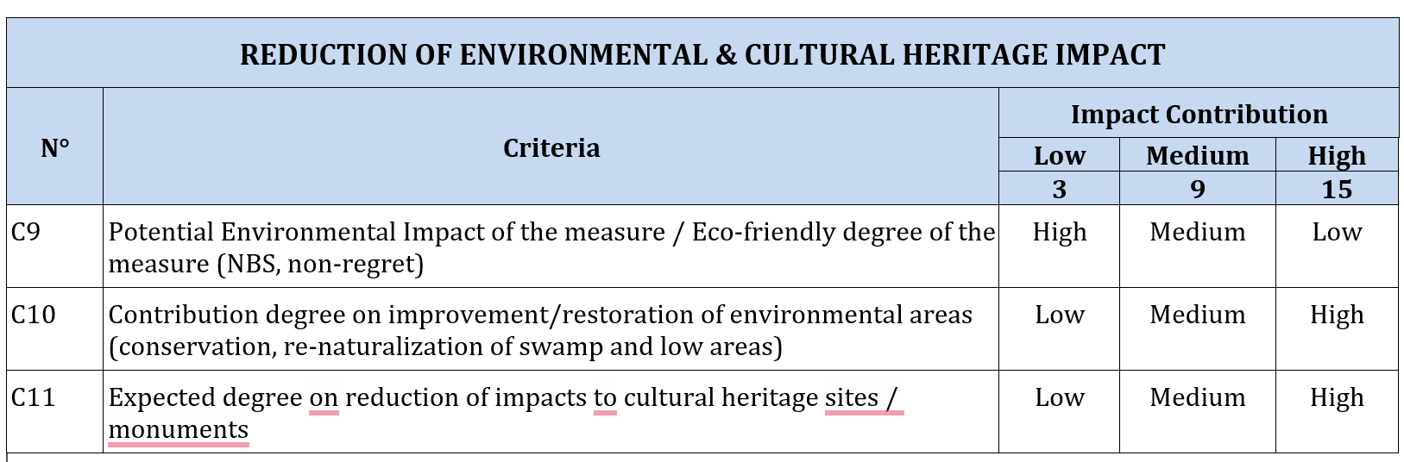
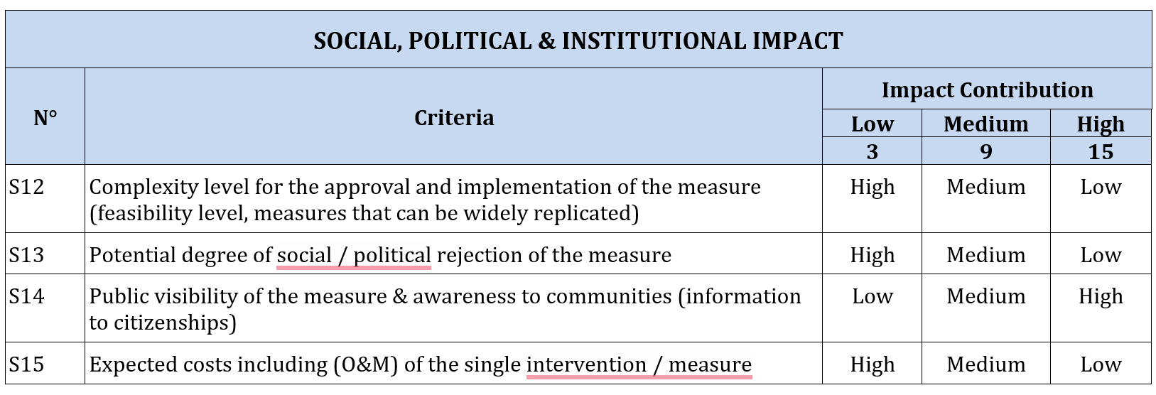
Scoring of the FRM Measures by Macro-area
Multi-Criteria Optioneering Analysis Tables
Optioneering Analysis Tables
Economic Impact, 3 sub-criteria (E6 – E8),
Environmental Impact, 3 sub-criteria (C9 – C11)
Social Impact, 4 sub-criteria (S12 – S15)

Slide 21
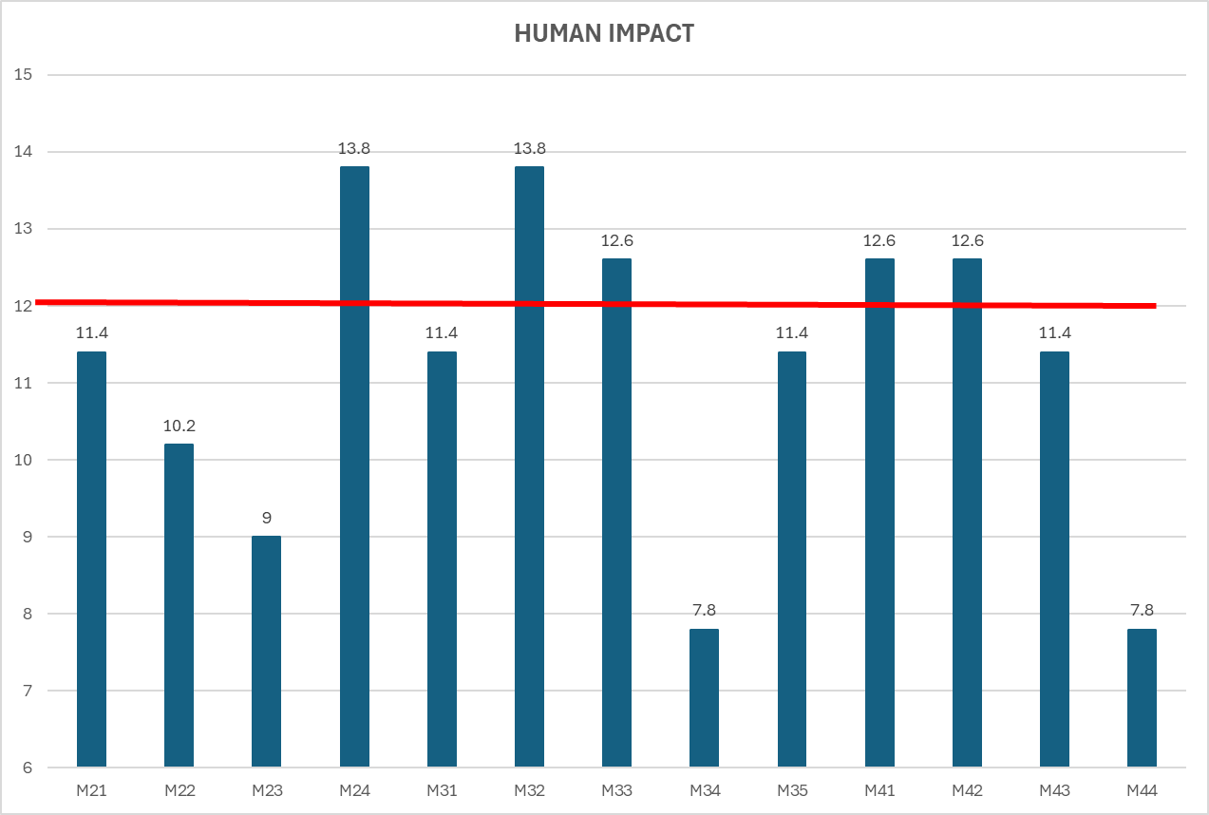
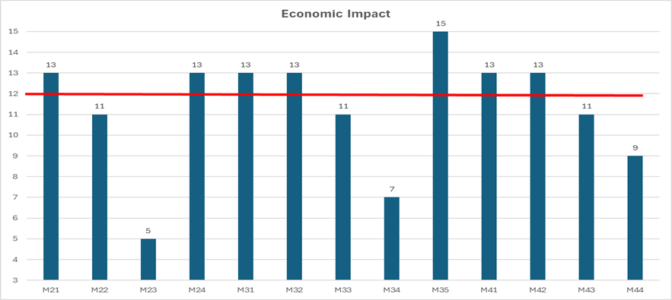
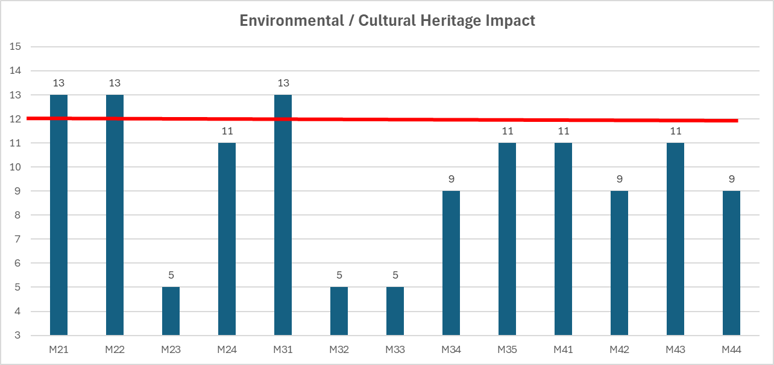
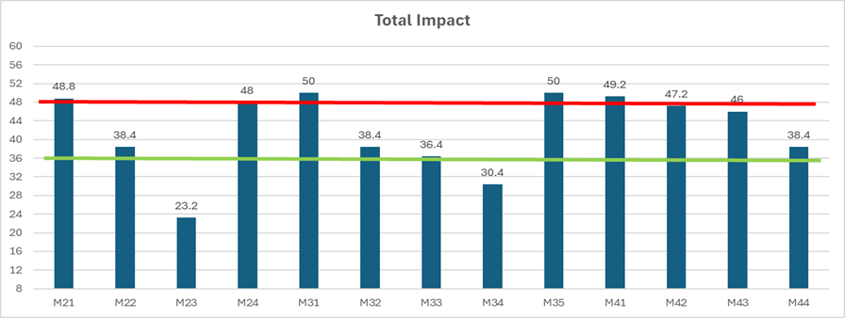
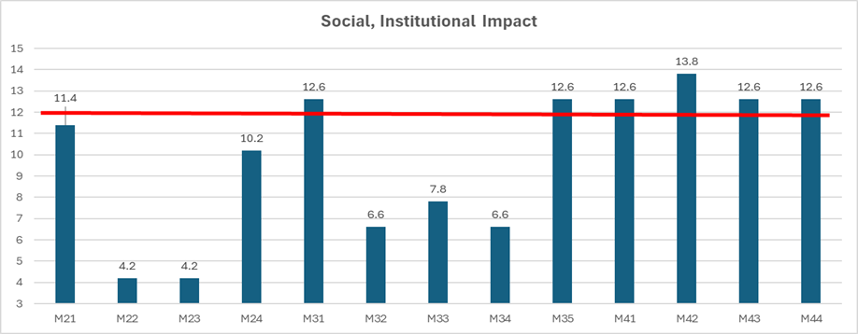
Scoring the FRM Measures by H.F. Macro-areas
Scoring the 4 Impact Categories (13 FRM Measures)
Assessing the Total Impact of the FRM Measures
The (Scoring) Multi-Criteria Optioneering Analysis was done for the four (4) impact categories and thirteen (13) FRM Measures. Excluded the FRM Measures: No Action (M11), Recovery (M51 – M53), and Other (M61).
The Total Impact Score (total contribution reducing flood risk) was calculated as the normalized average of the four (4) impact categories.

Slide 22
Prioritization of the FRM Measures by Macro-area
Total Impact (Lower Drin)
Threshold Table
Ranking and Prioritization of the FRM Categories
According to the “Total Impact” obtained (contribution degree reducing the flood risk), the FRM Measures were classified into three (3) categories, based on the above threshold table.
The FRM categories with a Total Impact greater than 48 were ranked as High priority, the categories with Total Impact in the range 36 – 48 were ranked as Medium Priority, and the Measures with Total Impact lower than 36 were ranked as Low priority. The prioritization process was done for each single macro-area. The criteria and thresholds can be optimized.

Slide 23
Ranking of the FRM Measures by Macro-area
Lower Drin
The results achieved do not pretend to be “definitive”, a first attempt that can be optimized
The scoring was done by 3 experts (2 regional + 1 international), results could vary.

Slide 24
Ranking of the FRM Measures by Macro-area
Medium / Upper Skadar
The results achieved do not pretend to be “definitive”, but a first attempt.
The scoring was done by 3 experts (2 regional + 1 international), results could vary.

Slide 25
Ranking of the FRM Measures by Macro-area
Drin Cascade
The results achieved do not pretend to be “definitive”, but a first attempt.
The scoring was done by 3 experts (2 regional + 1 international), results could vary.

Slide 26
Ranking of the FRM Measures by Macro-area
White Drin
The results achieved do not pretend to be “definitive”, but a first attempt.
The scoring was done by 3 experts (2 regional + 1 international), results could vary.

Slide 27
Ranking of the FRM Measures by Macro-area
Upper Lakes
The results achieved do not pretend to be “definitive”, but a first attempt.
The scoring was done by 3 experts (2 regional + 1 international), results could vary.

Slide 28
Summary Table
Transboundary High-Priority
FRM Measures

Slide 29
Transboundary High-Priority FRM Measures
It Can Be Observed:
Only Six (6) FRM categories were identified as high-priority. Two (2) prevention (M21, M24), two (2) protection (M31, M35), and two (2) Preparedness (M41, M42).
The Lower Drin is the only macro-area that includes all six (6) high-priority FRM measures.
M31 – Natural Flood Management is the sole FRM Measure common for all homogeneous flooding macro-areas

Slide 30
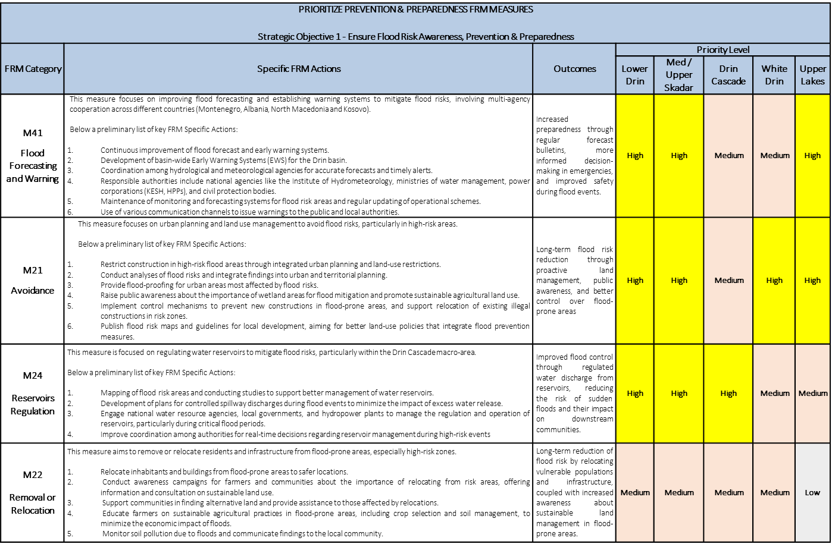
Summary Table - Axis of Action I
Ensure Flood Risk Awareness, Preparedness & Good Governance

Slide 31
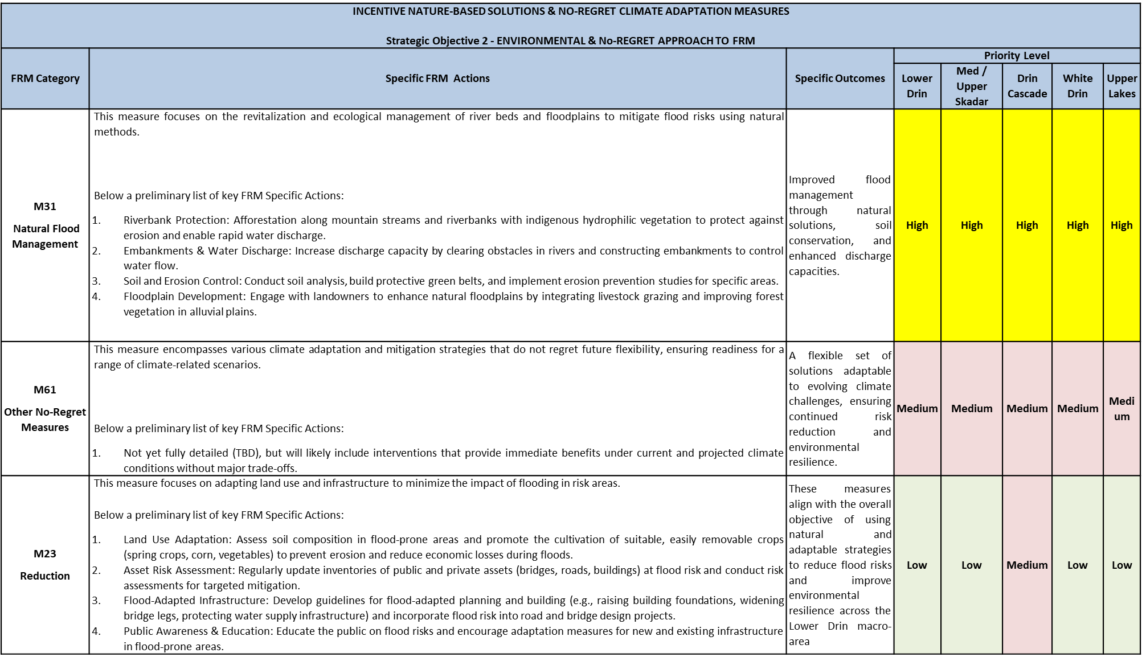
Summary Table - Axis of Action II
Incentive Nature Based Solutions & No-Regret Climate Adaptation Measures

Slide 32
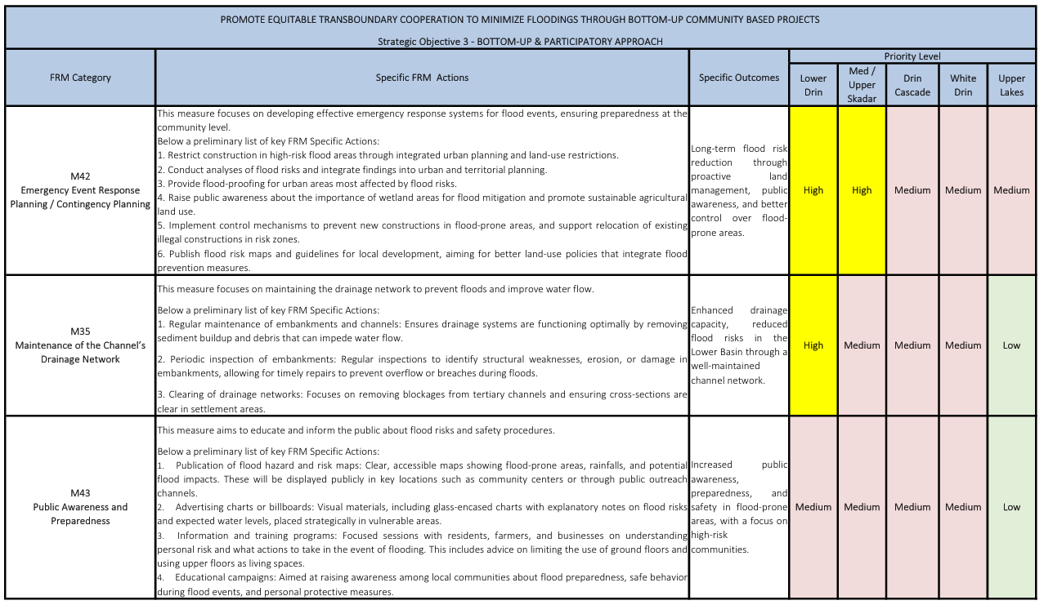
Summary Table - Axis of Action III
Promote Equitable Transboundary Cooperation and Bottom-Up Community Based Projects

Slide 33
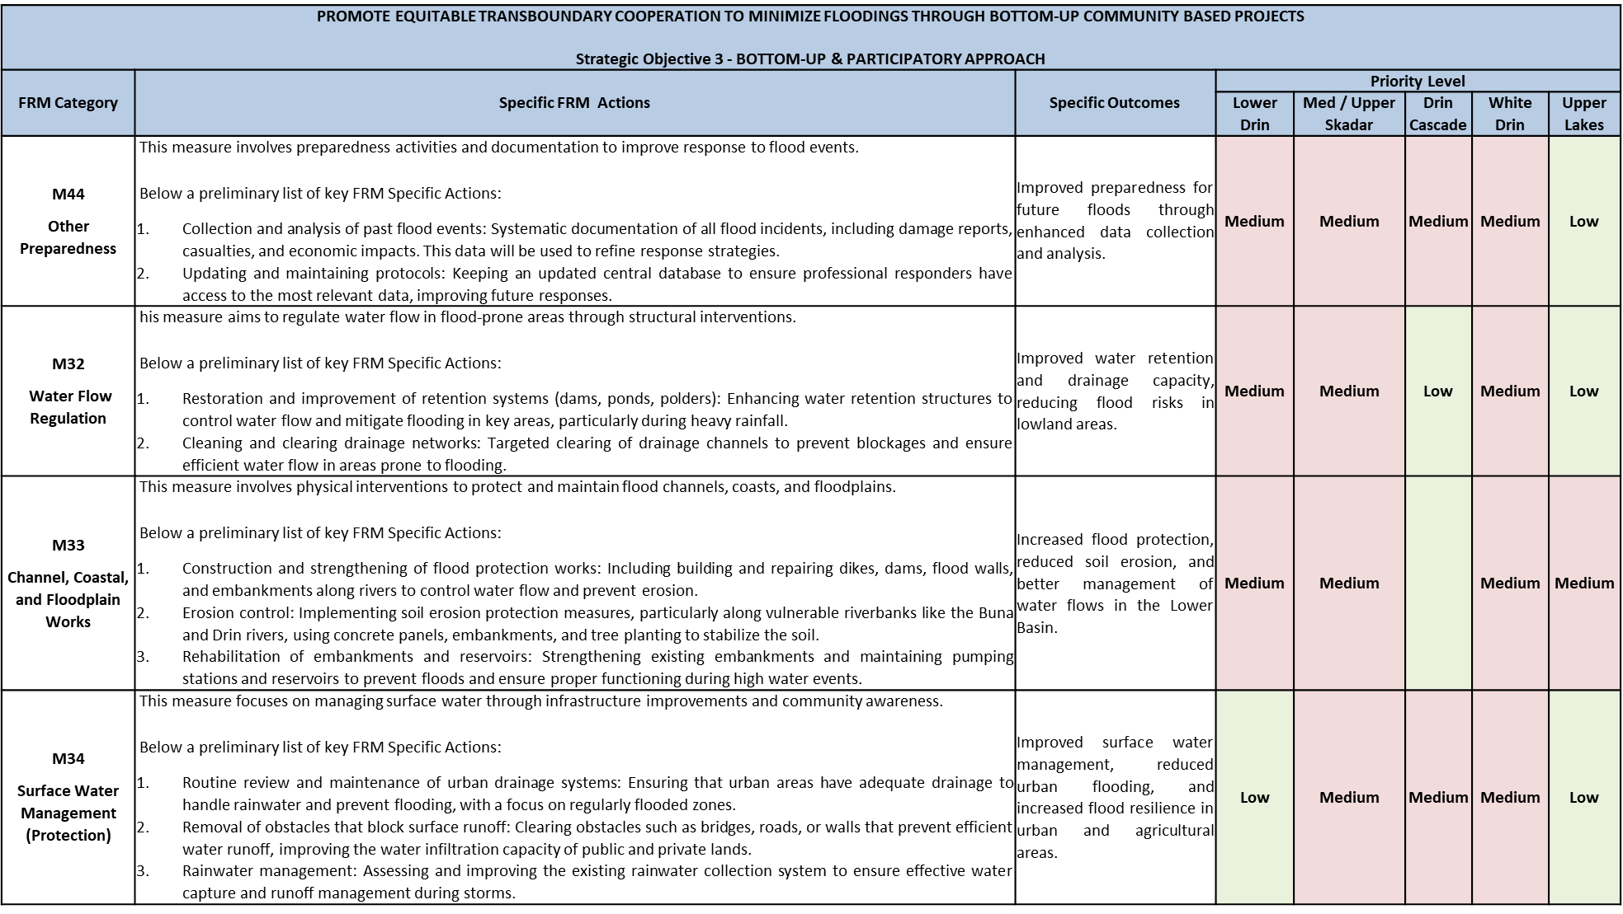
Summary Table - Axis of Action III
Promote Equitable Transboundary Cooperation and Bottom-Up Community Based Projects

Slide 34
Other Transboundary High-Priority FRM Measures
Agriculture Sector:
Improve the agricultural resilience in flood-prone areas, Development and Enforcement of Sustainable Land Use Policies (Coping with Floods)
Improvement of drainage systems
Energy (Hydropower) Sector:
Enhance Reservoir Storage Capacities and Modernize Hydropower Facilities
Promote Regional Cooperation and Integrated Water Management
Risk Financing & Risk Transfer
Promotion of Insurance products and Tax incentives (Italy, mandatory since 01/01/25)
Public awareness campaigns about the need for private risk financing
Institutional Strengthening & Investment Plan
Strengthening key riparian institutions related to hydro-climatic risks
Hydro-climatic risks cannot rely on a single lead agency, it’s necessary a joined-up government approach involving key agencies
Promote the constitution of a Transboundary Drin River Basin Commission (DRBC)

Slide 35
Specific FRM Actions
By Homogeneous Flooding Macro-Areas

Slide 36
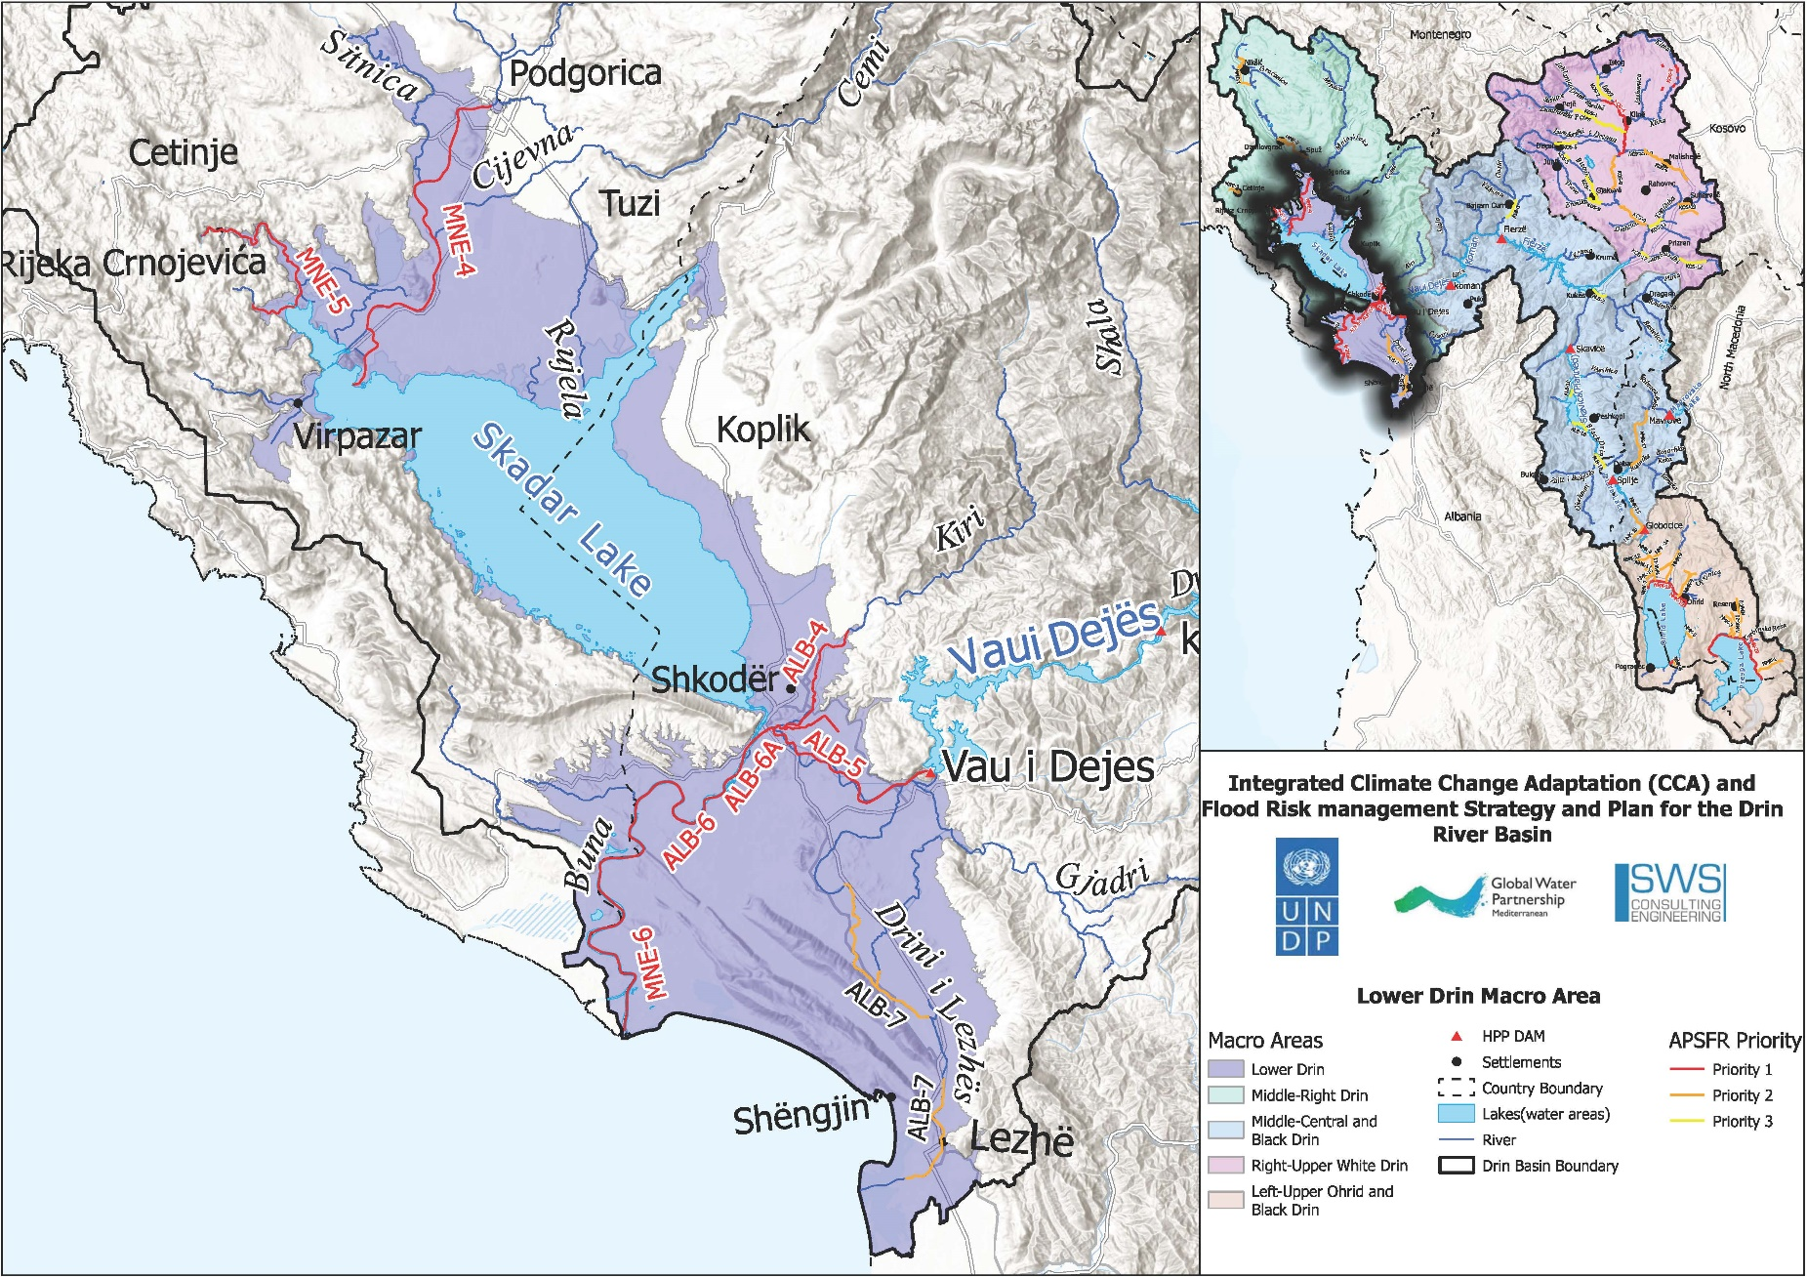
Lower Drin Macro-Area

Slide 37
High Priority Specific FRM Actions Albania/Montenegro
M41 – Flood Forecasting and Warning
  Continuous Improvement of flood forecast and flood warning
  Development of the basin wide EWS based on the Drin riparian’s improvements in flood forecast and flood warning
M21 – Avoidance
  Spatial/Urban Planning: Integrate flood risk analysis into urban/territorial planning, with building restrictions in high-risk areas.
  Flood Proofing: Develop flood-resilient urban infrastructure and define mandatory precautions for building protection.
  Risk Communication: Disseminate flood risk maps and information to urban planners and administrations through seminars and meetings.
  Construction Guidelines: Draft guidelines for construction and land use, limiting development in risk areas.
  Plan Reviews: Update local development plans to include flood risk management measures.
  Construction Control: Establish mechanisms to control and limit new constructions in flood-prone areas.
  Support for Illegal Constructions: Assist residents with illegal buildings to relocate from high-risk zones.
  Wetland and Agricultural Land Protection: Ensure appropriate use of agricultural land and prevent construction in wetland and floodplains, particularly in areas like the Viluni channel and Kir River.

Slide 38
High Priority Specific FRM Actions Albania/Montenegro
M24 – Other - Reservoirs Regulation
  Flood Risk Mapping and Studies: Conduct studies and mapping of flood risk areas, particularly focusing on reservoirs and their regulation.
  Set the Regulation of Reservoirs in Vau I Dejes and Koman for Flood Risks
  Construct Skavica Dam
  Flood Protection Areas: Identify areas of interest for flood protection and adapt areas of mutual importance accordingly.
  Coordination in International Basins: Coordinate with international partners on Areas with Potentially Significant Flood Risk (APSFR) in shared basins.
  Preparation of further hydromorphological studies covering the area of Lake Skadar and the Bojana River in order to assess possible measures to reduce the negative impacts of floods caused by heavy rainfall and the rise in the level of Lake Skadar.

Slide 39
High Priority Specific FRM Actions Albania/Montenegro
M31 – Natural flood management
  Revitalization of River Beds and Banks: Afforestation along mountain streams and riverbanks (Kir and Buna Rivers) using indigenous hydrophilic vegetation to reduce erosion and enhance water discharge.
  Changing River Courses: Adjust obstacles (like constructions) in canals to increase transport capacity and extend discharge capacity through international agreements (Belaj bottleneck in Buna River).
  Construction of embankments and pumping stations (Kuç village) to manage floodwaters.
  Protection of Riverbank Zones:Clean riverbeds and banks (Kir River) and define disposal areas for solid inert materials to avoid water pollution.Build green belts along streams (Pistalli Stream) and protect riverbanks with vegetation (Drin and Buna Rivers).
  Support of Natural Floodplains:Promote sustainable livestock grazing and improve forest vegetation (Velipoja area) in floodplains to protect soil and reduce erosion.
  Modified Extensive River Maintenance:Reconstruct the Buna Riverbed from Bahçallek to the Estuary.

Slide 40
High Priority Specific FRM Actions Albania/Montenegro
M42 – Emergency Event Response Planning / Contingency planning
  Financial Preparedness: Promote insurance against natural hazards in high-risk areas through technical seminars with insurance companies.
  Resident Awareness: Raise awareness of flood insurance for property owners in flood-prone areas.
  Civil Protection Plans: Prepare evacuation maps, train communities for emergencies, and construct first-aid stations (pods) for livestock and people during floods.
  Alarm System Maintenance: Ensure the maintenance of the alarm system by KESH for high-risk flood areas.
  Monitoring and Forecasting Systems: Maintain hydrometeorological systems in the Drin River cascade.
  Evacuation Tools: Provide and maintain safe mobility means (metal boats, etc.) for evacuation.
  Supporting development of joint protection and rescue plans in flood events between municipalities.
  Supporting joint simulation exercises of response in flood events among various stakeholders.
  Identification of areas of interest for flood Protection - Consideration of proposals and adaptation of areas of mutual importance for flood protection
M35 – Other – Maintenance of the channel’s drainage network
  Maintenance of embankments: Regular checks of embankments to ensure stability and functionality.

Slide 41
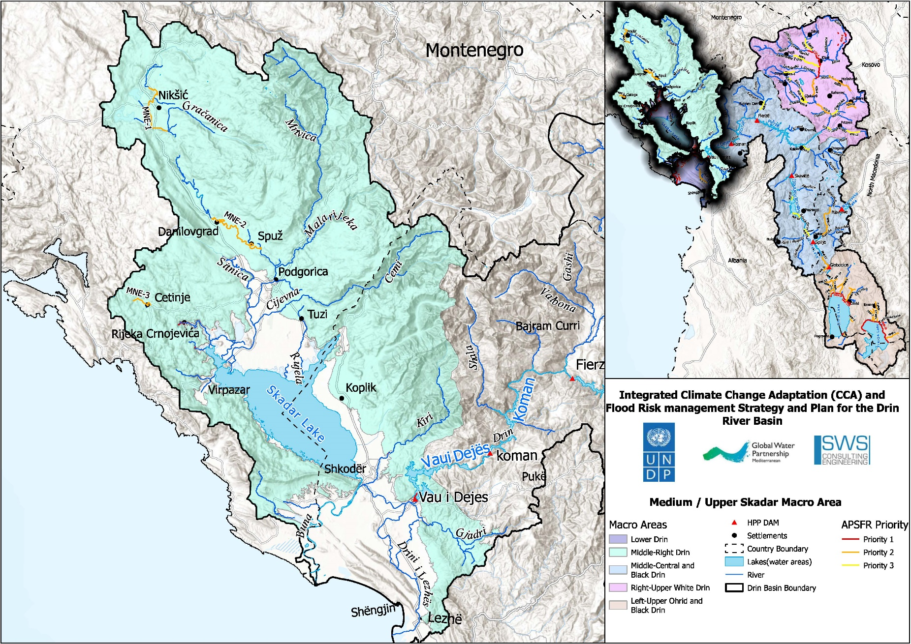
Medium Skadar/Shkoder Lake Macro-Area

Slide 42
High Priority Specific FRM Actions Albania/Montenegro
M41 – Flood Forecasting and Warning
  Continuous Improvement of flood forecast and flood warning
  Continuous improvement of the system for hydrological and meteorological observations including measurements of groundwater level and data transfer systems resulting in the process of setting up the early warning system.
  Development of the basin wide EWS based on the Drin riparian’s improvements in flood forecast and flood warning
M21 – Avoidance
  Restriction for building in risk areas (in spatial planning / urban planning), Integrated urban planning towards flood resilient facilities; provide flood proofing for the most affected urban areas.
  Protection of the flood plains and retention areas
M24 – Other - Reservoirs Regulation
  Mapping of flood risk areas.
  Development and approval of Local FRM Plan
  Implementation of Hydrogeological investigations in order to define the dimensions and spatial position of the revealed karst channels and their hydrological function (APSFR 03 – Cetinje field MNE)

Slide 43
High Priority Specific FRM Actions Albania/Montenegro
M31 – Natural flood management
  Revitalization of river beds and river banks / former flood plains
  Protection of zones along river banks
  Support of the development of natural floodplains
M42 – Emergency Event Response Planning / Contingency planning
  Financial precautions by reserves and insurances (insurance against natural hazards).
  Civil Protection.
  Alignment or optimization of alert and operation schemes (disaster management schemes).

Slide 44
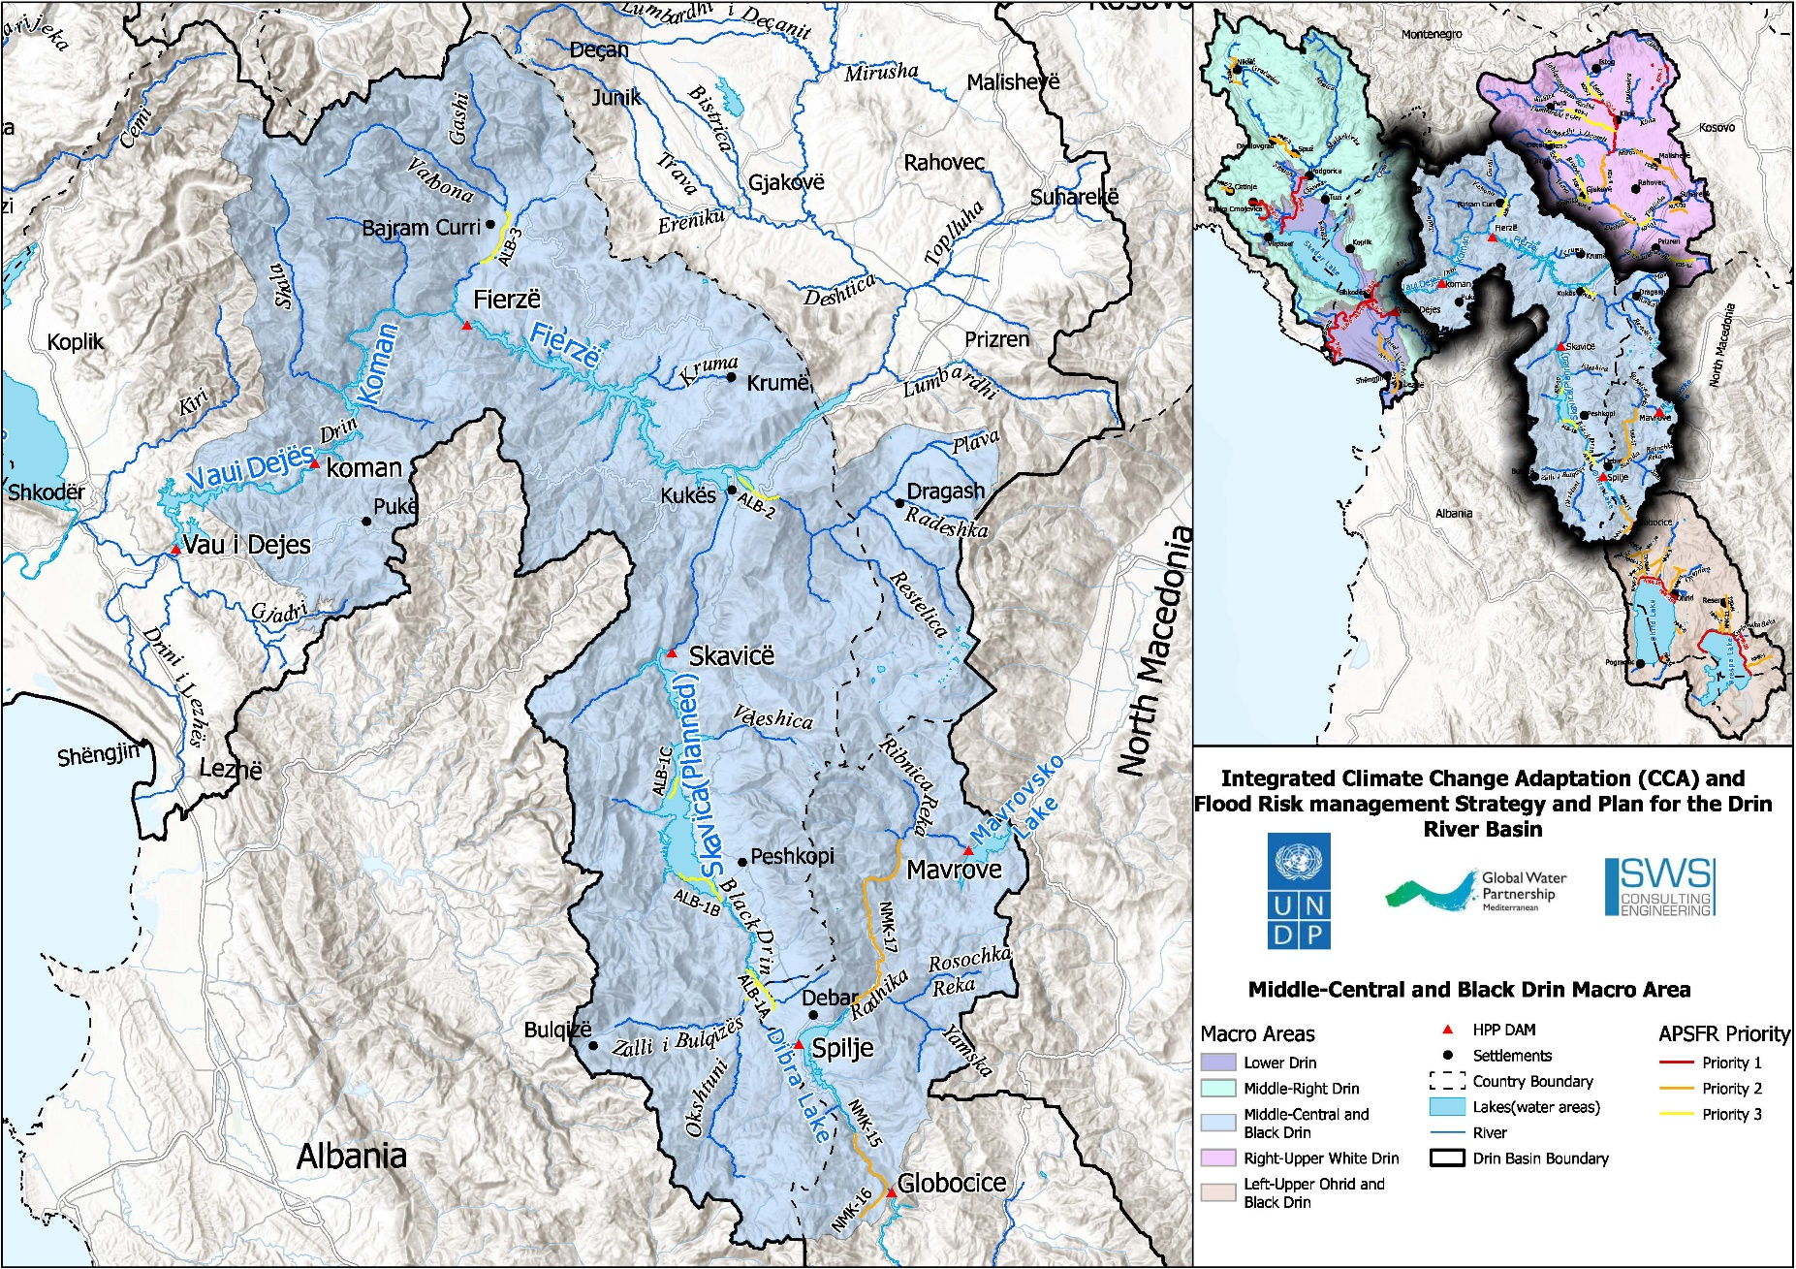
Drin Cascade Macro-Area

Slide 45
High Priority Specific FRM Actions
Albania/North Macedonia
M24 – Other – (Reservoirs Regulation*)
  Set the Regulation of Reservoirs in Fierza, Vau i Dejes , Koman for Flood Risks
  Construct Skavica Dam
  Awareness-raising projects in high schools and secondary Schools
  Carry out regular updates of Hazard and Risk maps according to the legal provision or in cases when significant changes occur that need to be considered and integrated / further development of database
  Provision of digital flood hazard and risk maps based on a web-GIS platform to facilitate decision-making on flood risk management (including regular updating).
  Distribution of information leaflets, including flood risk maps and guidance information for the population in case of emergency (combined with measure 4.4.1-1 related with evacuation maps/points/streets in case of emergency)
  Distribution flood risk maps in the local administration at all levels
  Maintaining, supplementing and updating on the websites of central and local institutions information on flood risk management, self-protection, flood hazard maps, flood risk assets, new flood events, water access levels and relevant scenarios for each area, and interactive guidance.

Slide 46
High Priority Specific FRM Actions
Albania/North Macedonia
M31 – Natural flood management
  Afforestation along mountain streams
  Adjustment and cleaning of obstacles (constructions, crossings, tombs)
  Compilation of studies in order to determine the areas where river inerts may or may not be used to reduce the effects of floods and use their conclusions as mandatory guidelines for implementation
  Education / cooperation with landowners or land users to encourage livestock integration Improvement of forest vegetation in areas of alluvial plains by planting autochthonous hydrophilic seedlings with strong root system
  Planting willows, acacias and poplars in the areas along the river side to reduce erosion
  Environmental assessment of flooded areas, to guide re sponsible institutions to assess the environmental situation before land use decisions etc., not just after a flood.
  Reconstruction of the riverbed

Slide 47
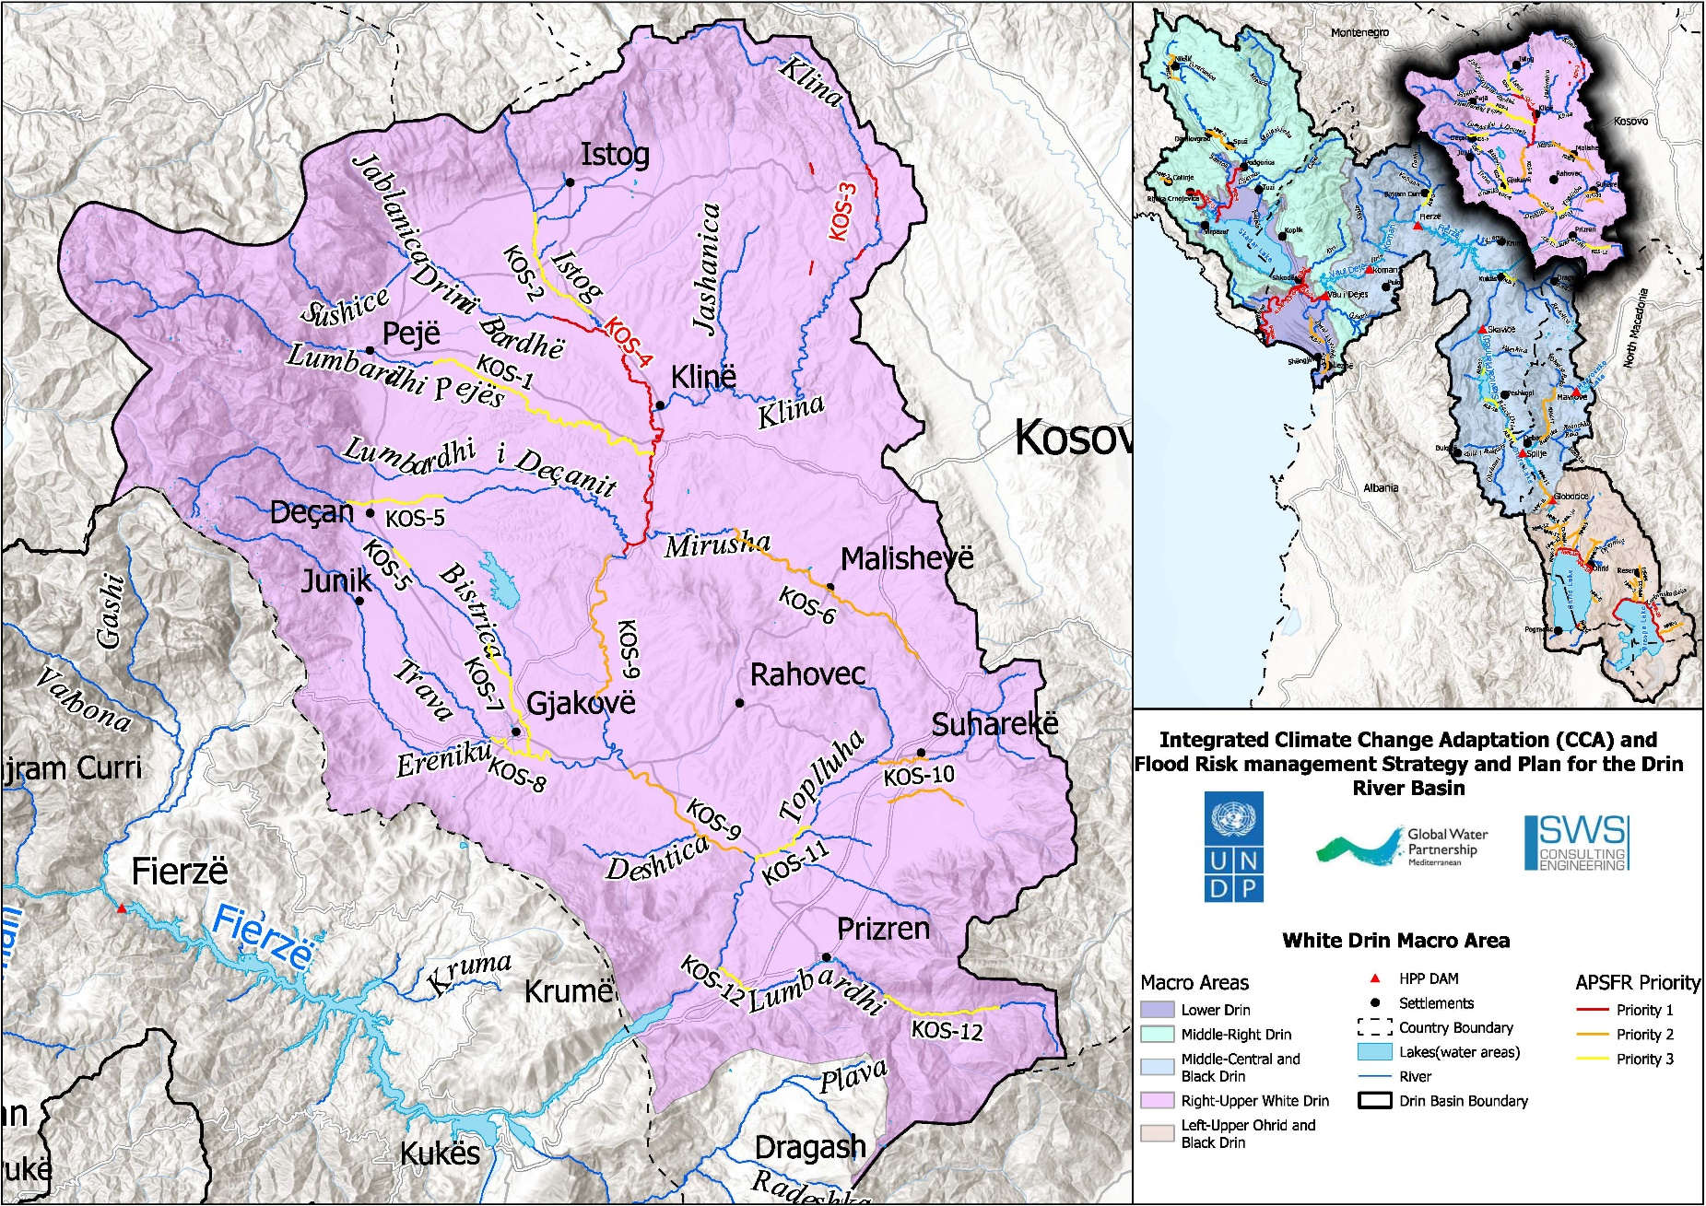
White Drin Macro-Area

Slide 48
High Priority Specific FRM Actions
Kosovo
M21 – Avoidance
  Spatial plans shell includes information presented on the hazard and risk maps regarding the flood spatial distribution, in order to prevent the construction of any buildings and urbanization in areas that are at risk of flooding.
M31 – Natural flood management
  Afforestation along mountain streams
  Adjustment and cleaning of obstacles (constructions, crossings, tombs)
  Compilation of studies in order to determine the areas where river inerts may or may not be used to reduce the effects of floods and use their conclusions as mandatory guidelines for implementation
  Education / cooperation with landowners or land users to encourage livestock integration Improvement of forest vegetation in areas risked from flood
  Planting willows, acacias and poplars in the areas along the river side to reduce erosion
  Environmental assessment of flooded areas, to guide re sponsible institutions to assess the environmental situation before land use decisions etc., not just after a flood.
  Reconstruction of the riverbed

Slide 49
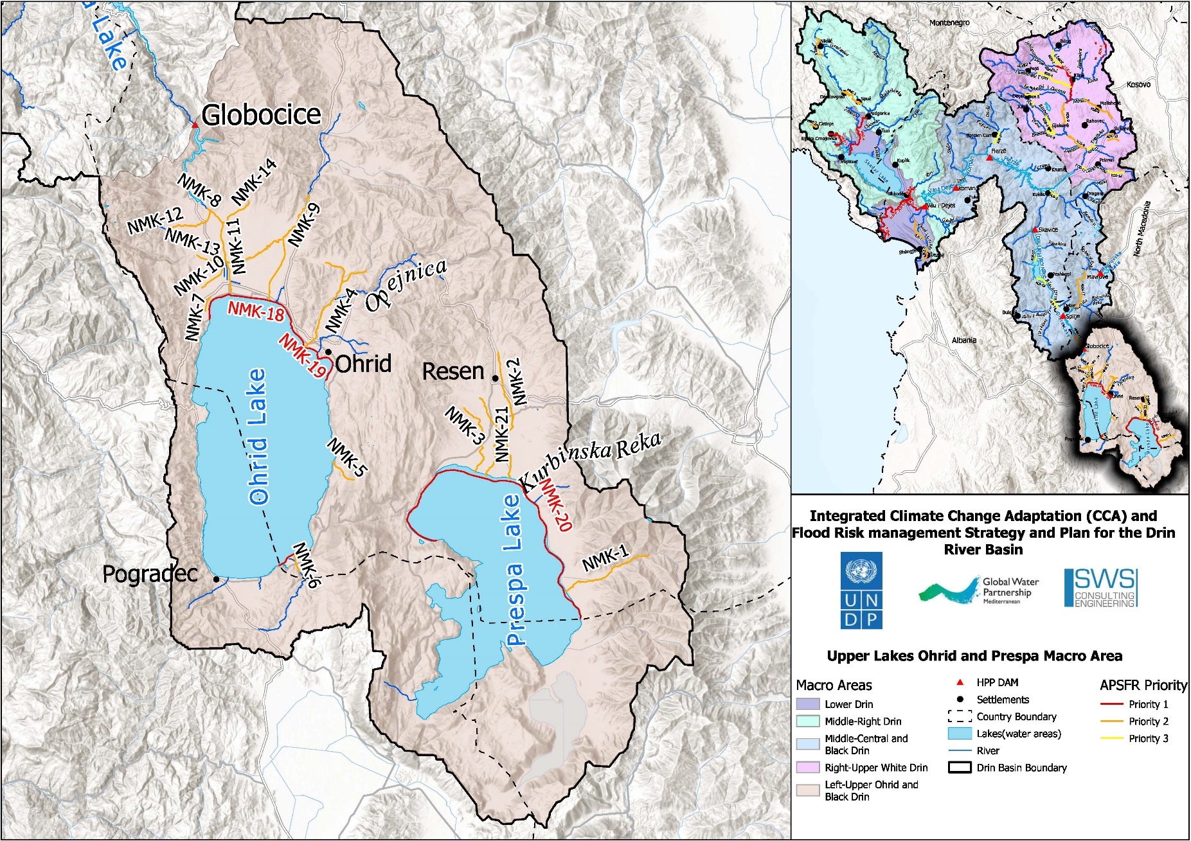
Upper Lakes Macro-Area

Slide 50
High Priority Specific FRM Actions
North Macedonia/Albania
M41 – Flood Forecasting and Warning
  Continuous Improvement of flood forecast and flood warning –
  Further development of early warning systems specifically addressing flash floods resulting from intense rainfall, with a small spatial and temporal scale.
  Development of the basin wide EWS based on the Drin riparian’s improvements in flood forecast and flood warning
M21 – Avoidance
  Restriction for building in risk areas (in spatial planning / urban planning), Integrated urban planning towards flood resilient facilities; provide flood proofing for the most affected urban areas.
M31 – Natural flood management
  Afforestation of eroded land
  Riverbank Protection: Afforestation along mountain streams and riverbanks
  Revitalization of the existing drainage network using former flood plains

Slide 51
THANKS FOR ATTENTION
Doubts, Clarifications ?

Slide 52
CONSULTATION PROCESS
Stakeholder Engagement for Validation of the FRM Strategy & FRM Action Plan
(Novak Cadjenovic)*

